Slide 1
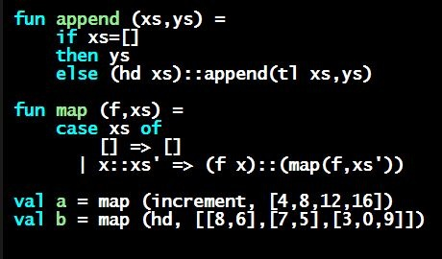
Programming Languages Dan Grossman University of Washington
Welcome to the Class!

Slide 2
Welcome!
Challenging opportunity to learn the fundamental concepts of programming languages
With hard work, patience, and an open mind, this course makes you a much better programmer
Even in languages we won’t use
Learn the core ideas around which every language is built, despite countless surface-level differences and variations
Poor course summary: “Uses ML, Racket, and Ruby”

Slide 3
Introductory material
This video:
Course mechanics, structure, etc.
Other introductory videos
Who I am and staff acknowledgements
Initial “why study programming languages this way”
Real course-motivation in 2-3 weeks
Discussion of recommended background
Why “the course” is divided into Parts A, B, and C
Grading policies
Overall “roadmap” particularly upcoming weeks

Slide 4
Concise to-do list
Get familiar with all the materials on the webpage
Whether or not this is your first Coursera course
Several things different/unusual
2. Get set up using Emacs [optional] and SML [required]
Installation/configuration/use instructions on web page
And videos if you need
Essential; non-intellectual
No reason to delay!
3. Optional “dummy” Homework 0

Slide 5
Course materials
Video lectures: most necessary, others labeled “optional”
Reading notes
Same material as lectures, but more precise and complete
So: optional but recommended
Lecture code
To avoid having to re-copy from .mp4/.pptx/.pdf
Homework assignments
Graded against test cases and peer graded
Exams
Cover topics harder to re-enforce with “just programming” because this is not just a programming course

Slide 6
Homework
One per major-course section (minus 1)
Each homework submitted “all at once”
Much more like a challenging university course than many MOOCS [10-12 hours / week?]
Doing the homework involves:
Understanding the concepts being addressed
Writing code demonstrating understanding of the concepts
Testing your code to ensure you understand and have correct programs
“Playing around” with variations, incorrect answers, etc.
Only (2) is graded, but focusing on (2) makes homework harder
Challenge problems: Low points/difficulty ratio
Do not make solutions publicly available

Slide 7
Note my writing style
Homeworks tend to be worded very precisely and concisely
I am a computer scientist and I write like one (a good thing!)
Technical issues deserve precise technical writing
Conciseness values your time as a reader
You should try to be precise too
Skimming or not understanding why a word or phrase was chosen can make the homework harder
By all means ask others if a problem is confusing
Being confused is normal and understandable – even encouraged
Once you’re unconfused, you might agree the problem wording didn’t cause the confusion

Slide 8
Welcome!
Great adventure for all of us
Hope to support an active, energetic community
More fun together even if I cannot meet all of you
This MOOC is one of “the neatest things I’ve ever done”
I hope you’ll think so too
Hope to stretch your mind and challenge you at every step
While giving you everything you need to succeed

